Slide 1

COMPUTER NETWORKING
LAB 9

Slide 2
WAN

Slide 3
OBJECTIVES
Establish HDLC encapsulation as the serial link layer protocol.
Change the DCE clock baud rate on a serial link.
Establish PPP encapsulation as the serial link layer protocol.
Implementation of PAP authentication on the PPP link.
Implementation of CHAP authentication on the PPP link.

Slide 4
Scenario
As an expanding enterprise business, multiple branch offices have been established and are to be part of the company s administrative domain. WAN solutions are required and as the network administrator the company you have been tasked with establishing HDLC and PPP solutions at the edge router to be carried over some service provider network, possibly MPLS, however the details of this have not been revealed to you since the service provider network remains outside of the scope of your task. R2 is an edge router located in the HQ and R1 and R3 are located in branch offices. The HQ and branches need to be established as a single administrative domain. Use HDLC and PPP on the WAN links, and establish authentication as a simple security measure.

Slide 5
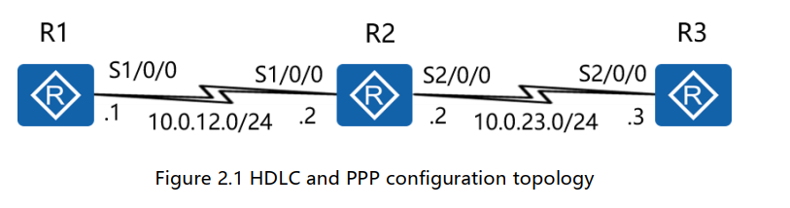
Topology

Slide 6
HDLC- High Level Data Link Control protocol
HDLC operate at layer-2 i.e. data link layer. It is also used for synchronous PPP connections.
It is bit oriented protocol.
On transmit side, HDLC receives data from application and delivers it to the receiver on the other side of link.
On receive side, HDLC accepts data and delivers to high level application layer.
Both side of HDLC modules exchange control information, encoded into a frame.

Slide 7
PPP-Point to Point Protocol
It is a byte-oriented protocol.
PPP operate at layer-2 and layer-3. It uses HDLC frame format at layer-2 and uses IPv4 and IPv6 formats at layer-3. Other than IP, it supports other network layer protocols also.
In addition, it also has built in security mechanism such as PAP and CHAP.
It also suffers from transparency problem as it uses same start and end flags as used in HDLC frame.

Slide 8
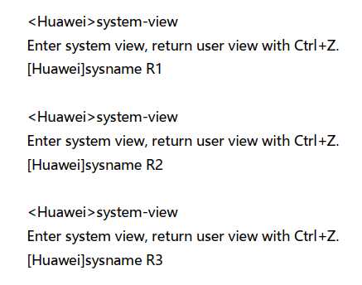
Preparing the environment
Change routers name

Slide 9
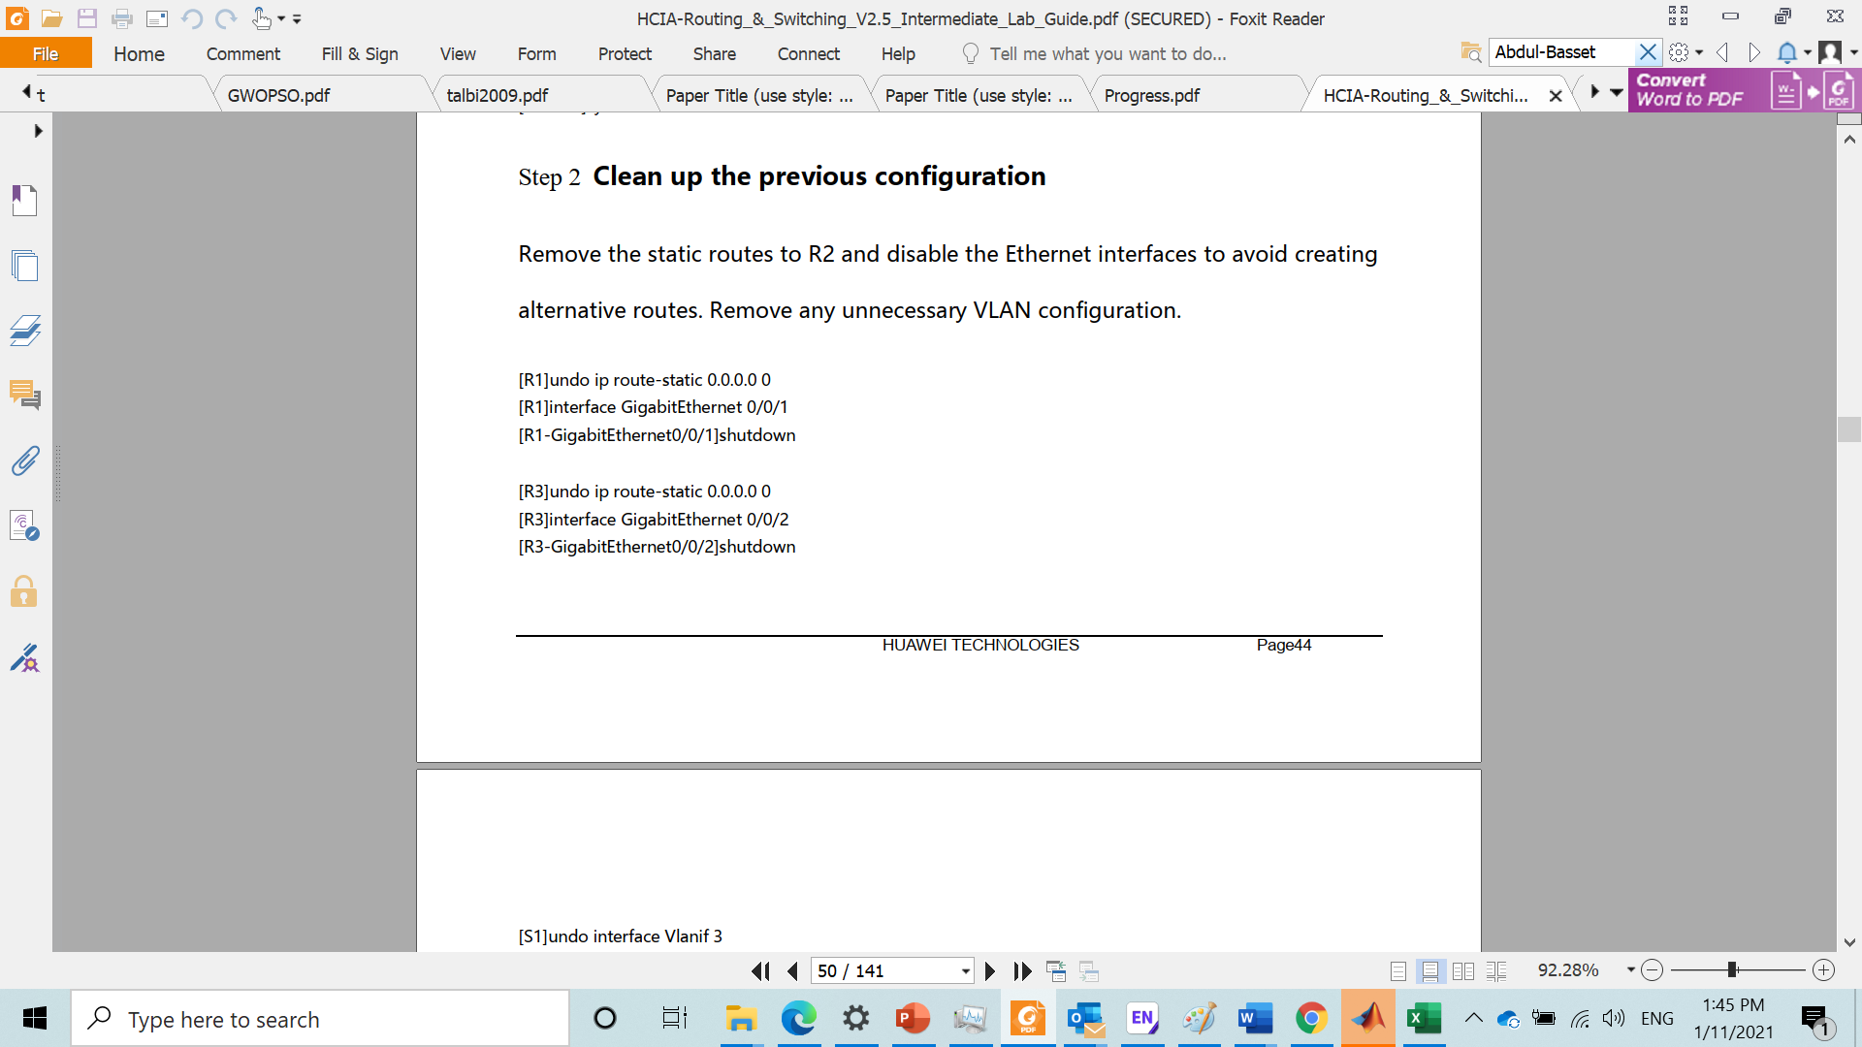
Clean up the previous configuration
Remove the static routes to R2 and disable the Ethernet interfaces to avoid creating alternative routes.
Remove unnecessary VLAN configuration.

Slide 10
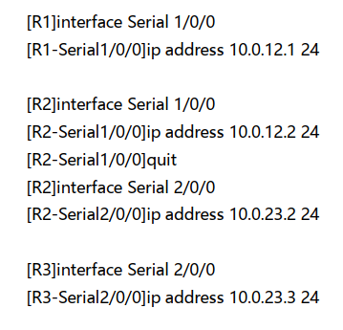
Configure serial interface IP addressing for R1, R2 and R3

Slide 11
HDLC PROTOCOL

Slide 12
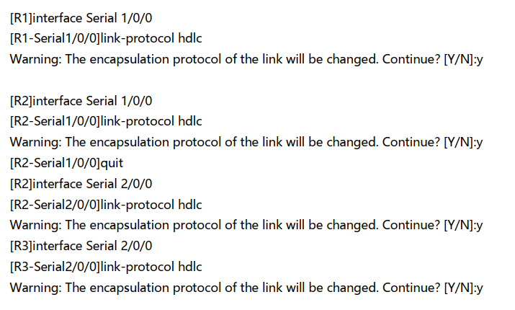
Enable the HDLC protocol on the serial interfaces

Slide 13
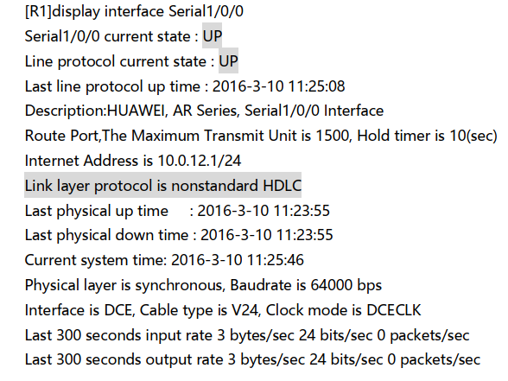
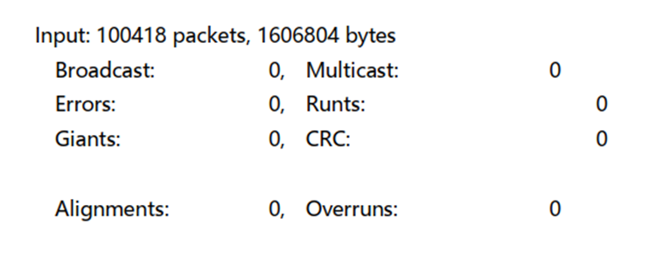
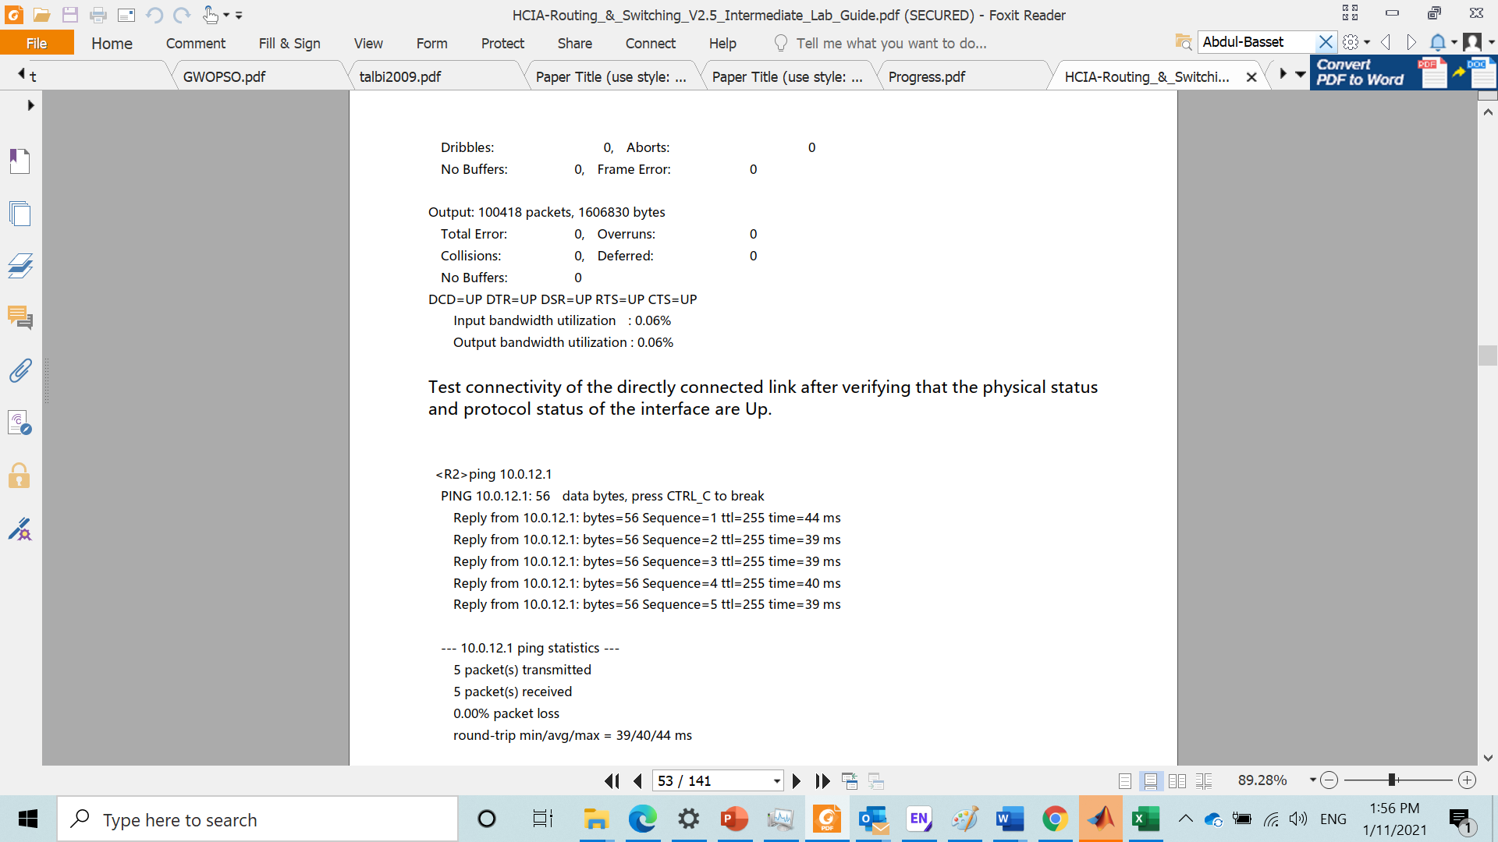
Enable the HDLC protocol on the serial interfaces
After enabling on the serial interfaces, view the serial interfaces status. The displayed information for R1 should be used as an example.

Slide 14
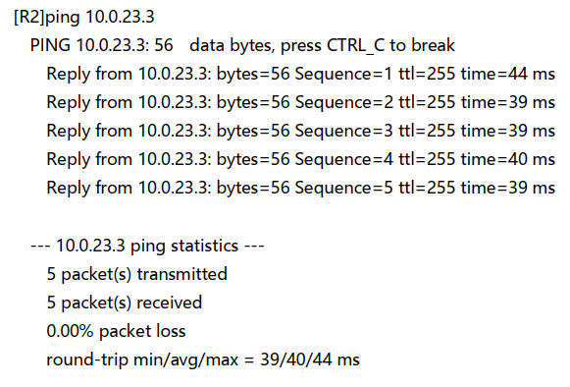
Enable the HDLC protocol on the serial interfaces
Test the connectivity of directly connected link after verifying that the physical status and protocol status of the interface are Up.

Slide 15
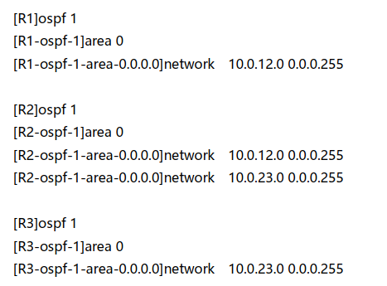
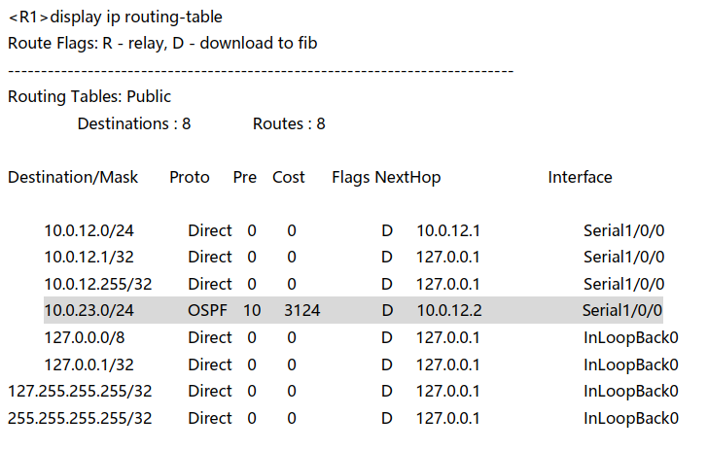
Configure OSPF
Enable the OSPF routing protocol to advertise the remote networks of R1 & R3
After configuration is complete, check that all the routes are learned by OSPF

Slide 16
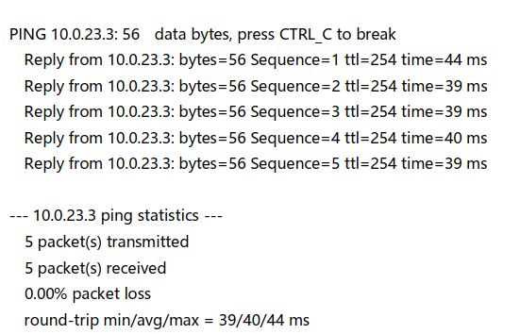
Configure OSPF
On R1, run the ping command to test connectivity between R1 and R3.

Slide 17
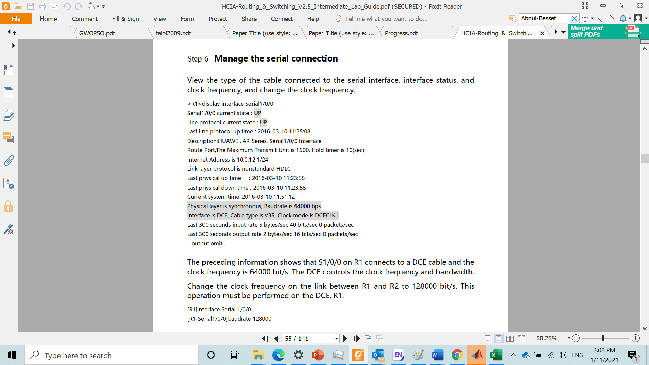
Manage the serial connections
View the type of the cable connected to the serial interface, interface status, and clock frequency, and change the clock frequency.
The preceding information shows that S1/0/0 on R1 connects to a DCE cable and the clock frequency is 64000 bit/s. The DCE controls the clock frequency and bandwidth.
Change the clock frequency on the link between R1 and R2 to 128000 bit/s.
This operation must be performed on the DCE, R1.

Slide 18
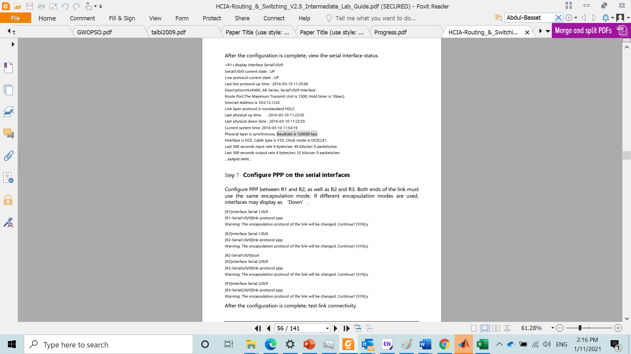
Manage the serial connections
After the configuration is complete, view the serial interface status.

Slide 19
PPP PROTOCOL

Slide 20
configure PPP on the serial interfaces
Configure PPP between R1and R2 as well as R2 and R3.
Both ends of the link must use the same encapsulation mode.
If different encapsulation modes are used, Interfaces may display as “down”.

Slide 21

configure PPP on the serial interfaces
After the configuration is complete, test link connectivity.

Slide 22
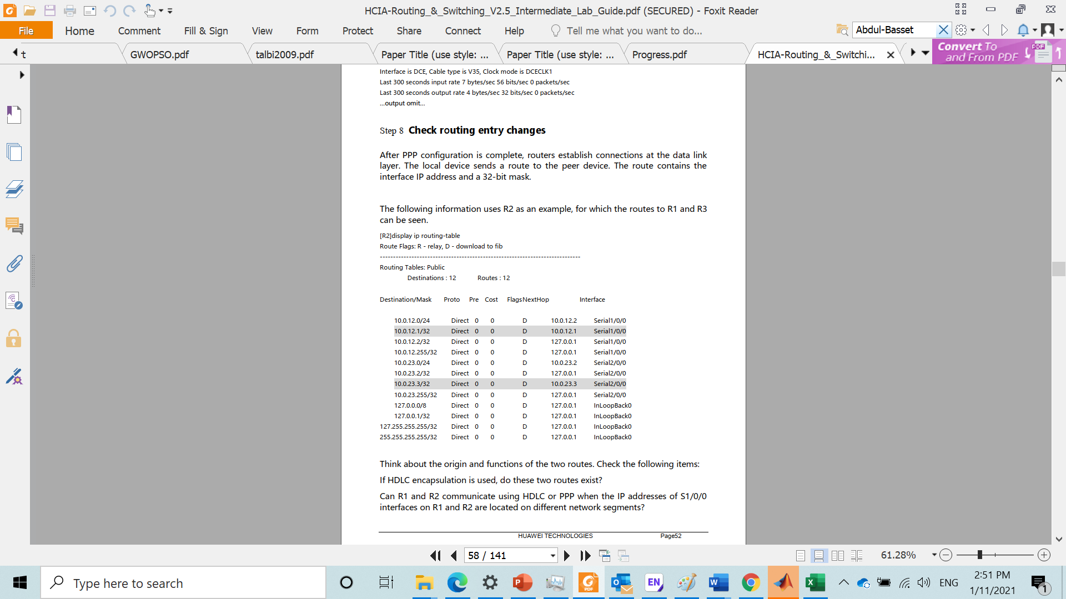
Verify the configuration by checking the connectivity
if the ping operation fails, check the interface status and whether the link layer protocol type is correct.

Slide 23
Check routing entry change
After PPP configuration is complete, routers establish connections at the data link layer.
The local device send a route to peer device.
The route contain the interface IP address and 32-bit mask.
The following information uses R2 as an example, for which the routes R1 and R3 can be seen.

Slide 24
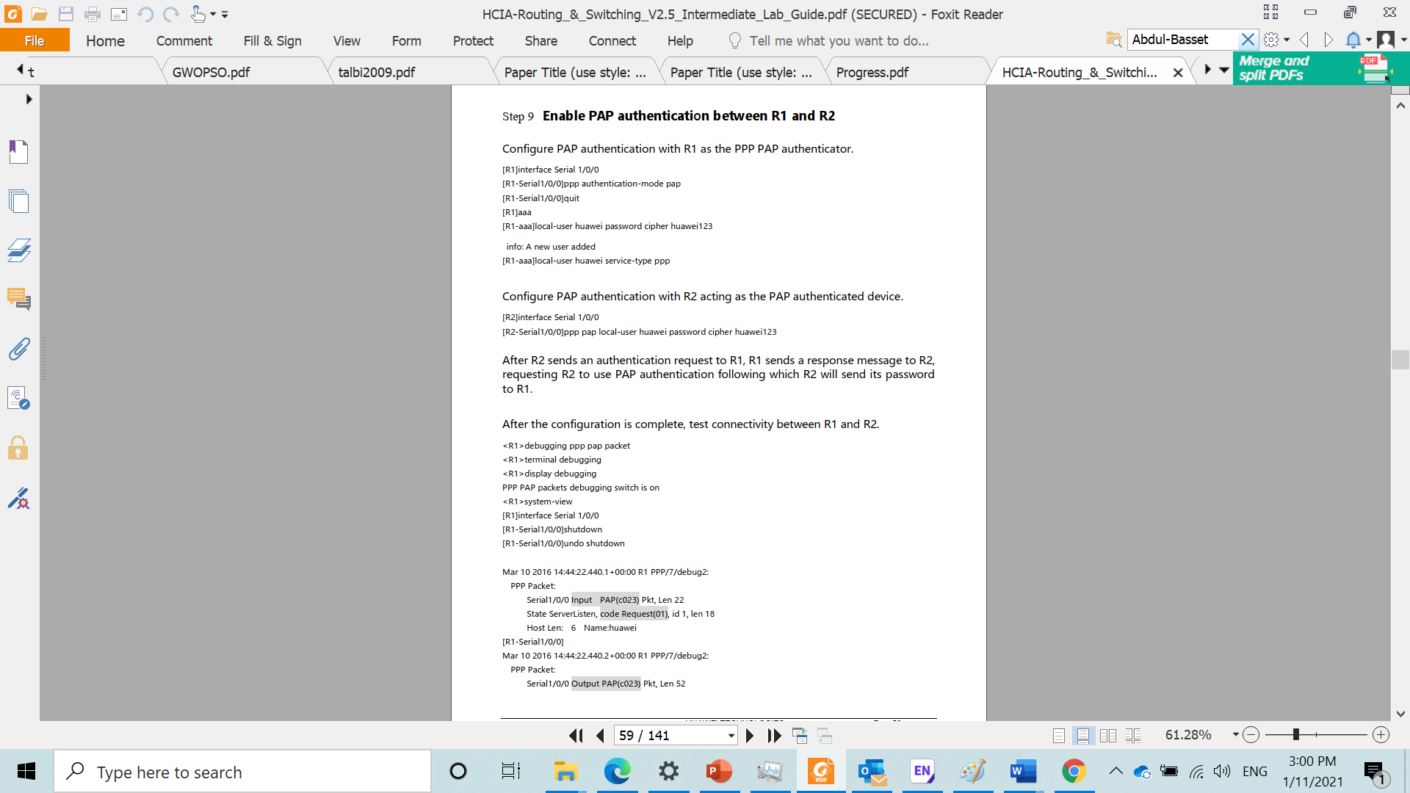
Enable PAP authentication between R1 and R2
Configure PAP authentication with R1 as the PPP PAP authenticator.
Configure PAP authentication with R2 acting as the PAP authenticated device.

Slide 25
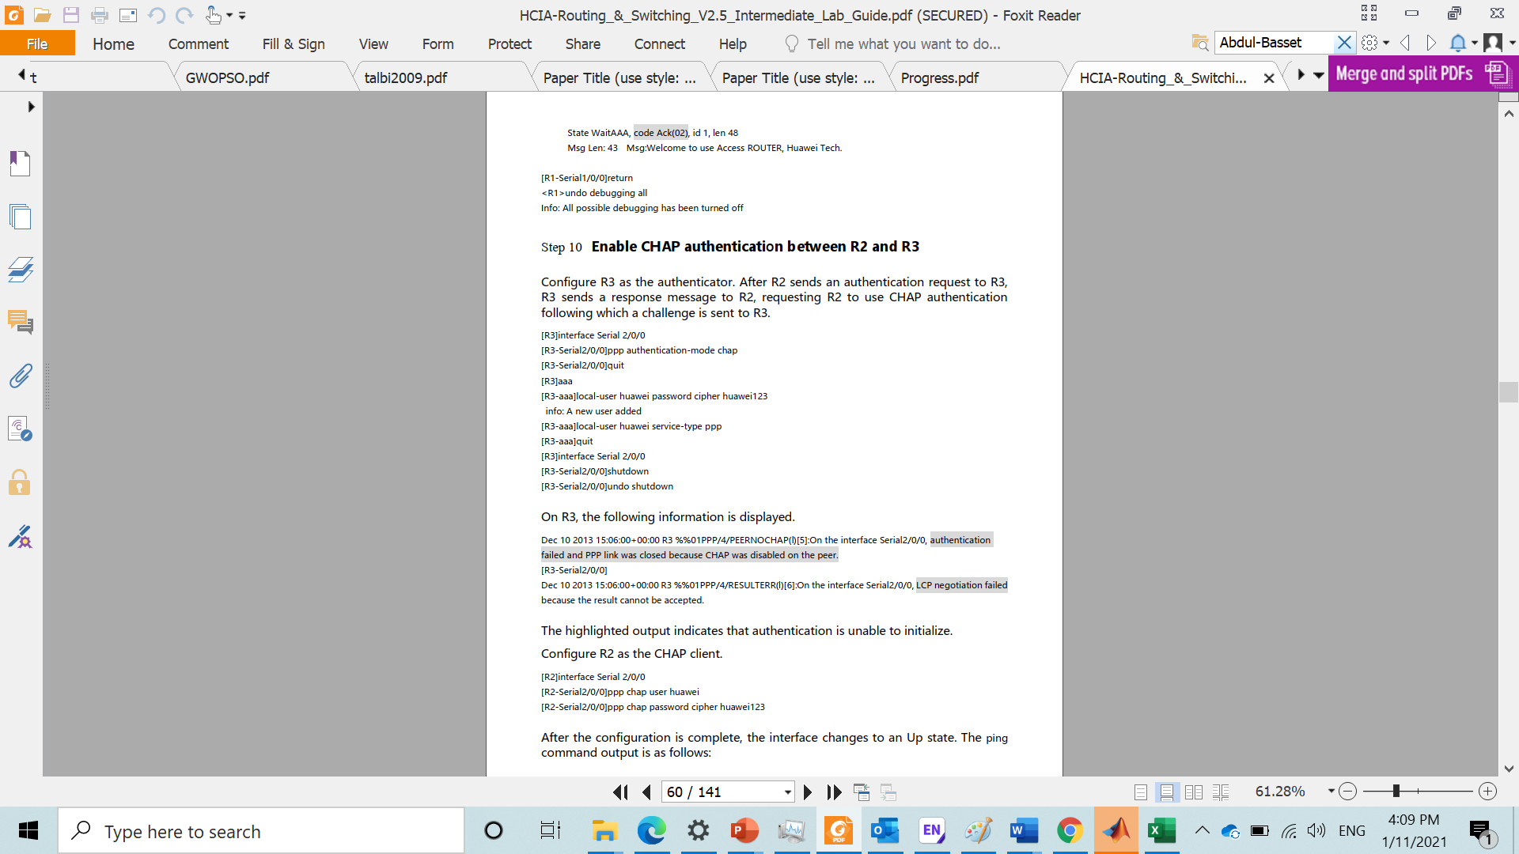
Enable PAP authentication between R1 and R2
After the configuration is complete, test connectivity between R1 and R2.

Slide 26
Enable CHAP authentication between R2 and R3
Configure R1 as the authenticator. After R2 sends an authentication request to R3, R3 sends a response message to R2, requesting R2 to use CHAP authentication following which a challenge is sent to R3.

Slide 27
Enable CHAP authentication between R2 and R3

Slide 28
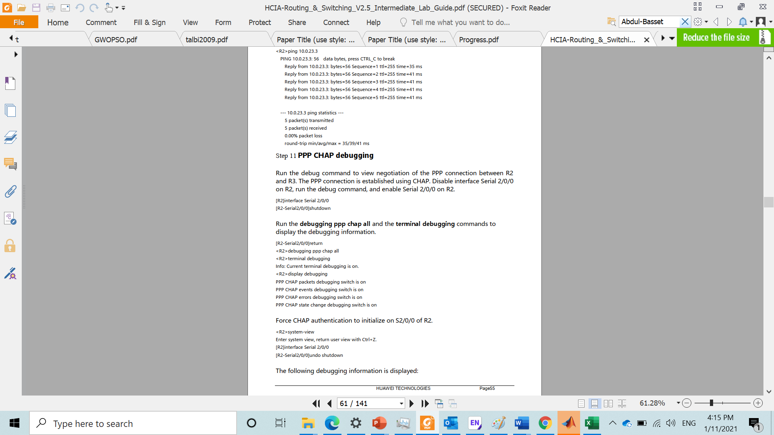
Enable CHAP authentication between R2 and R3
After the configuration is complete, test link connectivity.

Slide 29
PPP CHAP debugging
Run the debug command to view negotiation of the PPP connection between R2 and R3.
The PPP connection is established using CHAP.
Disable interface serial 2/0/0 on R2, run the debug command, and enable serial 2/0/0 on R2.
Run the debugging ppp chap all aand the terminal debugging commands to display the debugging information.
Force CHAP authentication to initialize on S2/0/0 of r2.

Slide 30

PPP CHAP debugging
The following debugging information is displayed

Slide 31
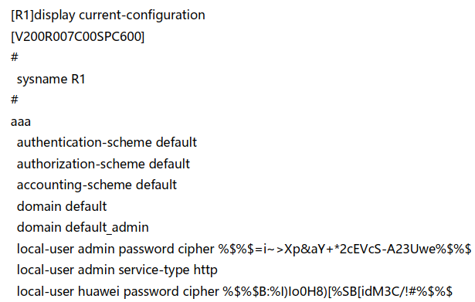
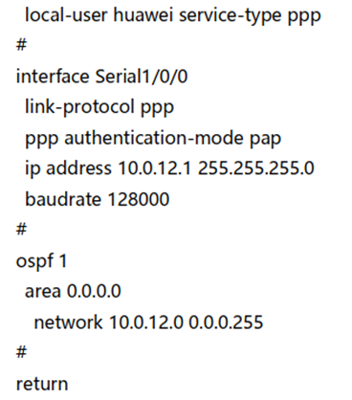
Final configuration

Slide 32
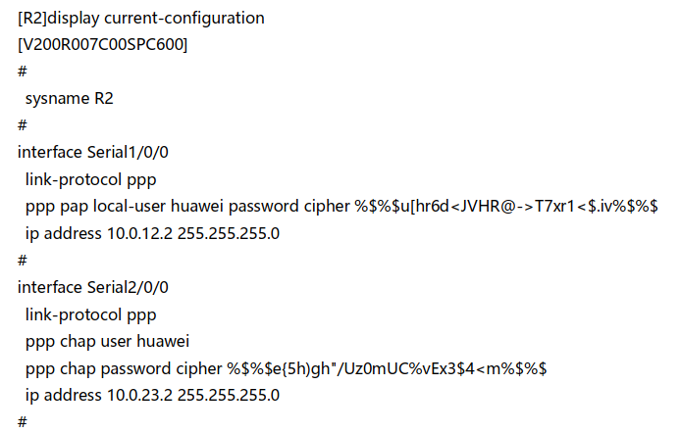
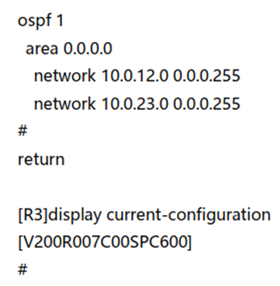
Final configuration

Slide 33
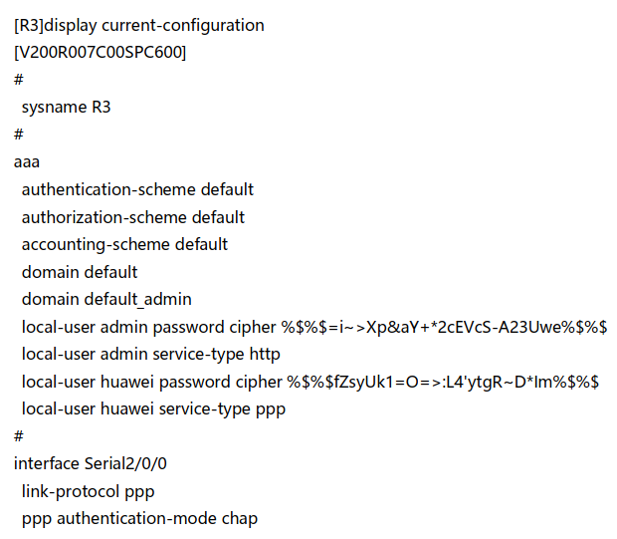
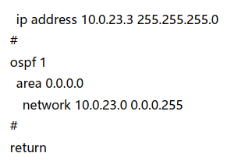
Final configuration

Slide 34
ASSIGNMENT
Draw a topo contain 3 routers then define a WAN network using PPP protocol and the authentication (PAP and CHAP) protocols.
- screenshot the command prompt
LAB 9

Slide 35
Thank you

